Slide 1

Aerothermochemistry and Combustion
Saleem Raza
Jeonbuk National University Department Of Mechanical Design Engineering
Heat Transfer and Reactive Flow Lab

Slide 2
Content
Introduction
Methodology
Numerical Procedure
Result and Discussion
Conclusion
Heat Transfer and Reactive Flow Lab

Slide 3
Introduction
The Power generation of PV cell is inherently effected by the amount of solar radiation
Tracking PV panels receive more radiation than fixed PV panel
A 1 degree increase in silicon cell temperature reduces the power output by 0.45%
Passive cooling techniques are used to cool PV panel without using the external Power to circulate heat transfer fluid , and no additional power is needed to cool
Phase change materials (PCM) have been used recently to absorb heat from PV panels without operation and maintenance cost
Heat Transfer and Reactive Flow Lab

Slide 4
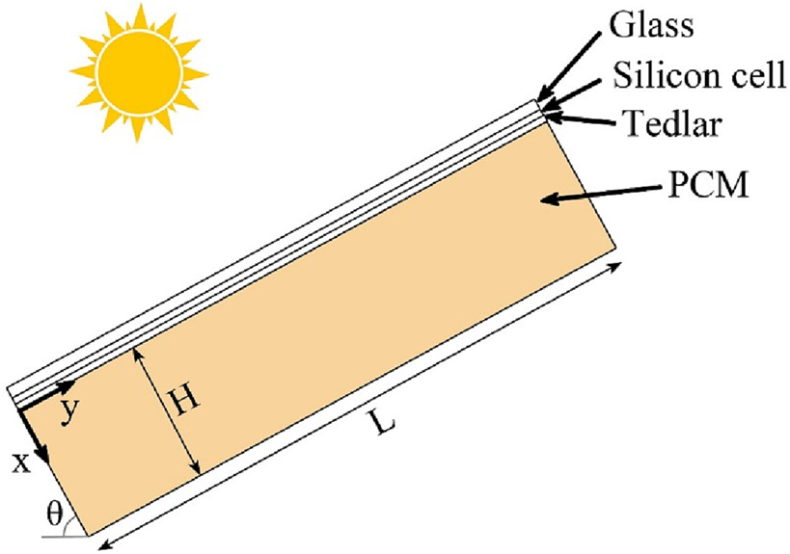
Methodology
Silicon layer is an opaque and absorbent material
A part of heat gained by the glass cover dissipates by convection to the ambient and radiation to the sky
The remaining energy is stored in the glass cover
Property | Glass cover | Silicon layer | Tedlar layer
Density (kg/m³) | 3000 | 2330 | 1200
Specific heat (J/kg K) | 500 | 677 | 1250
Thermal conductivity (W/m K) | 2 | 148 | 0.2
Thickness (mm) | 3 | 0.2 | 0.3
Fig. 1 : Schematic diagram of PV-PCM system
Table 1 : Properties of PV Module
Heat Transfer and Reactive Flow Lab

Slide 5
Methodology
For modeling melting process of phase change enthalpy-porosity technique is used
Mushy zone is modeled as a pseudo porous medium
The PCM density is modeled by Boussinesq approximation
PCM selected for this simulation is Calcium Chloride hexahydrate
Thermal property | Value
Melting temperature (K) | 302
Latent heat of fusion (kJ/kg) | 188
Specific heat
Solid (kJ/kg K) | 1.43
Liquid (kJ/kg K) | 2.31
Density
Solid (kg/m³) | 1710
Liquid (kg/m³) | 1580
Thermal conductivity
Solid (W/m K) | 1.09
Liquid (W/m K) | 0.5
Table 2 : Thermal Properties of PCM Calcium Chloride Hexahydrate
Heat Transfer and Reactive Flow Lab

Slide 6
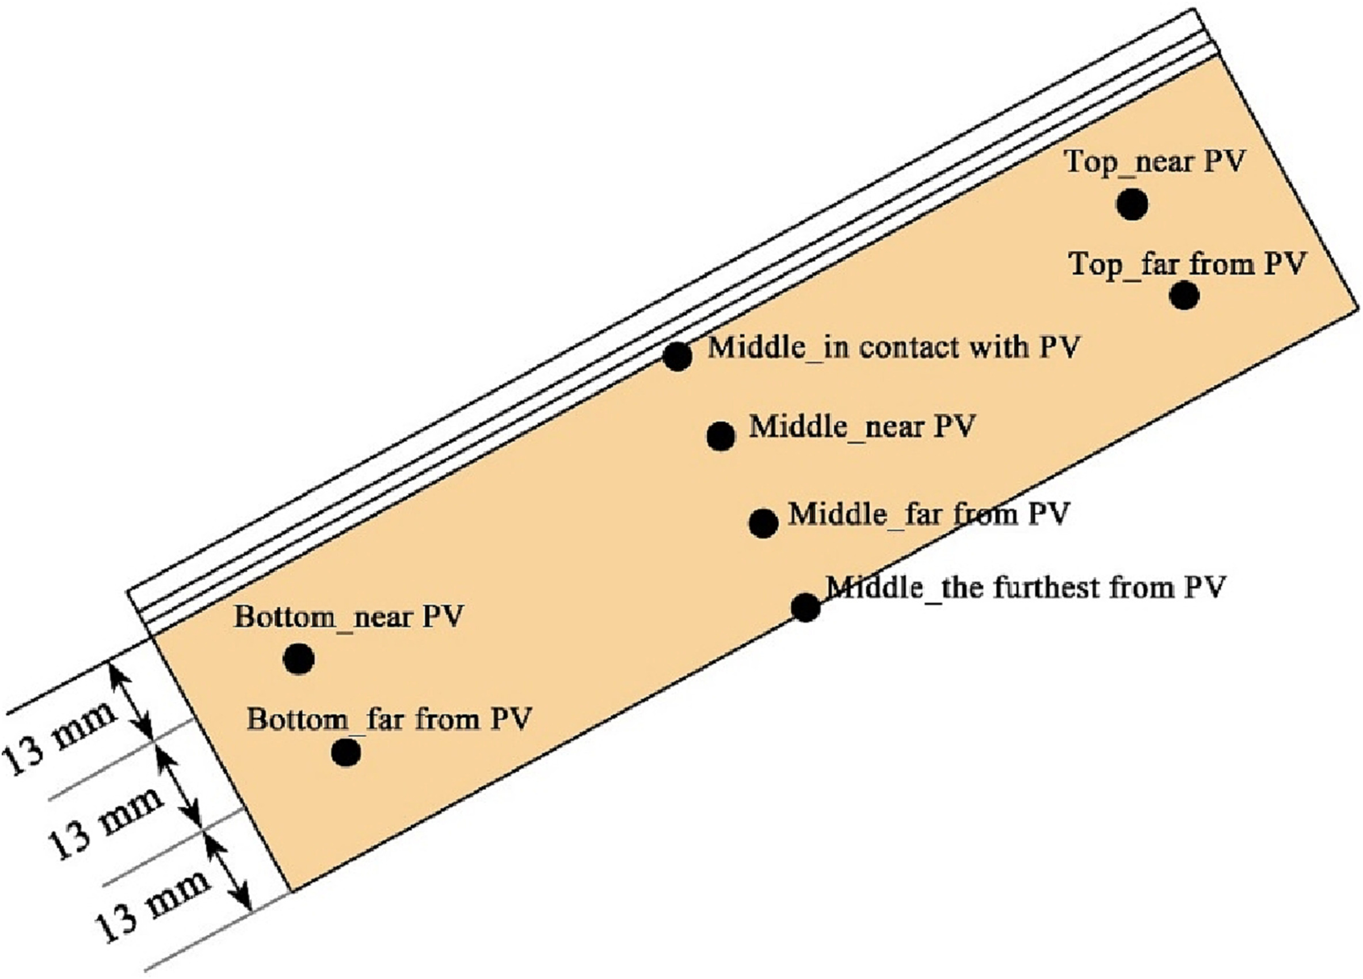
Numerical Procedure
Two axis sun tracker is used for the PV-PCM system in this model, the PV panel is perpendicular to the direction of the solar radiation at all times and heat flux has small variation
The PCM temperatures are calculated for a few specific points at Top, middle and bottom of the container
Fig. 2 : The positions for calculating PCM temperature
Heat Transfer and Reactive Flow Lab

Slide 7
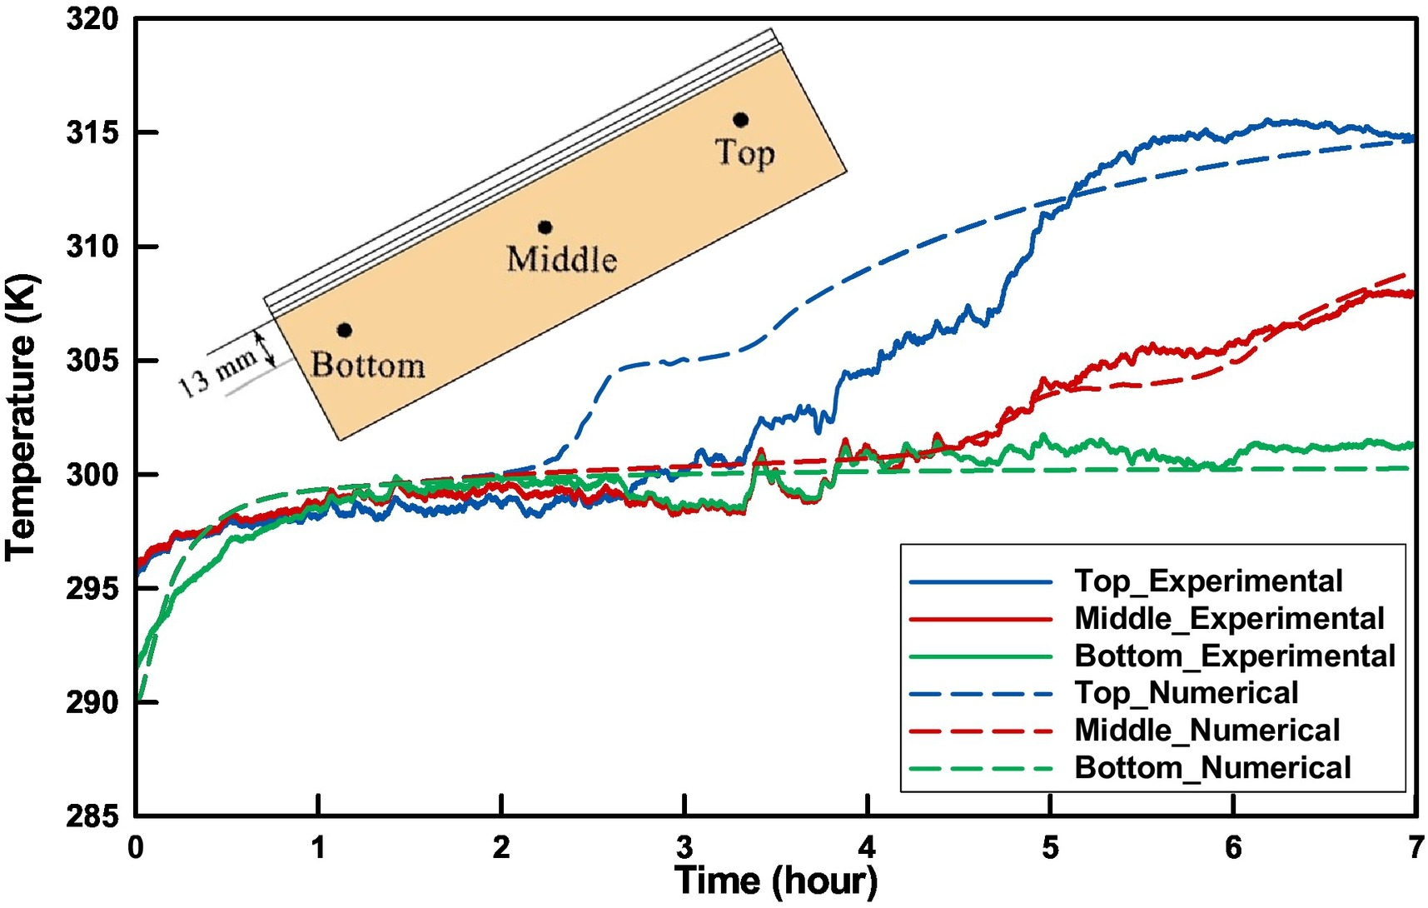
Experimental Validation
After the Designing the next step is Meshing
A Proper meshing size was assigned to generate mesh for all parts
SolidWorks provides default meshing through proper manager and it makes the whole process easy
Although the meshing could be done but it is very necessary to have the Control Mesh
Fig. 4: Numerical and experimental results for the PCM temperatures at the top, middle, and bottom of the container
Heat Transfer and Reactive Flow Lab

Slide 8
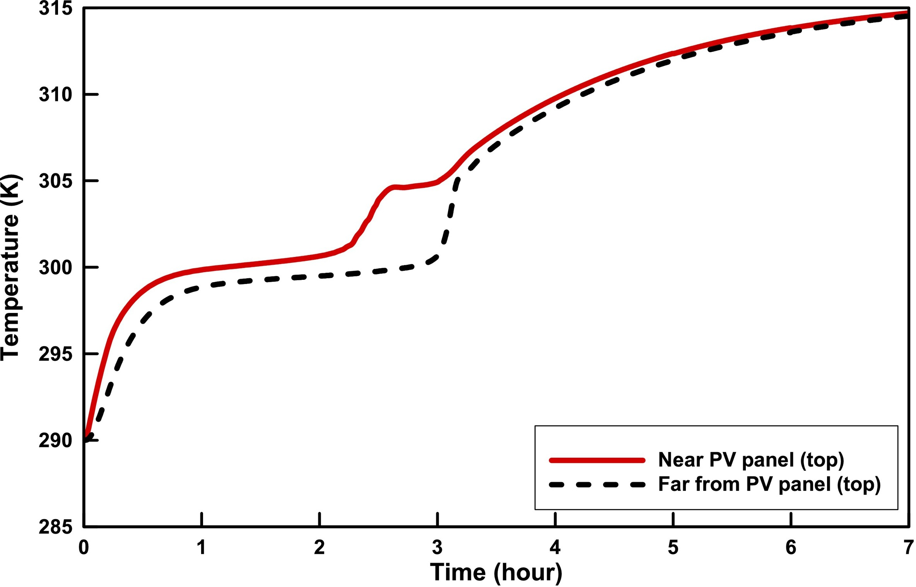
Results and discussion
The temperature of PCM near PV panel increases rapidly at the beginning. PCM remains solid in this phase, this is because of the high thermal conductivity of the PCM in solid state
The PCM near the PV panel melts completely in approximately 2.5h
After melting PCM the temperature starts increasing at considerable rate due to the conduction heat transfer in the stationary liquid
The buoyancy forces cause vortex in molten material
Fig. 5. The PCM temperatures at the top for distances of 13 mm and 26 mm from the PV panel.
Heat Transfer and Reactive Flow Lab

Slide 9
Results and discussion
The rotational motion of the vortex increases the rate of heat transfer form panel to the PCM
When the PCM near PV starts to melt , The PCM temperature of solid far from PCM panel remains constant due to constant temperature of Liquid solid interface
Fig. 5. The PCM temperatures at the top for distances of 13 mm and 26 mm from the PV panel.
Heat Transfer and Reactive Flow Lab

Slide 10
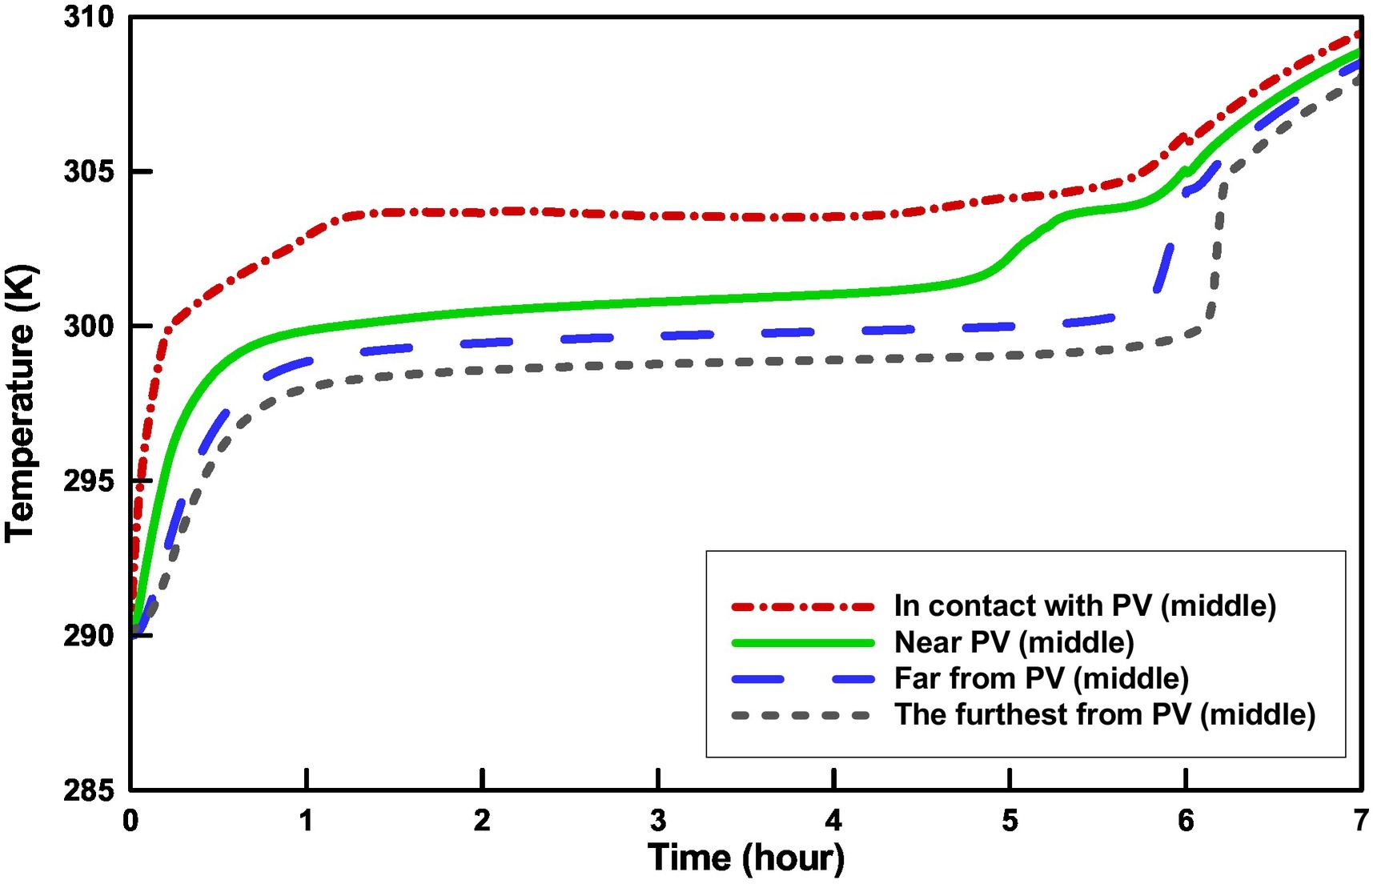
Result and Discussion
The temperature of the molten material in contact with the PV cell continue to increase as long as vortices and convection starts
As the distance of the point decreases from the PV panel the temperature slop decreases
As the material surrounding the PV melts the temperature starts increasing sharply
Fig. 6. The PCM temperatures for different distances from the PV panel
Heat Transfer and Reactive Flow Lab

Slide 11
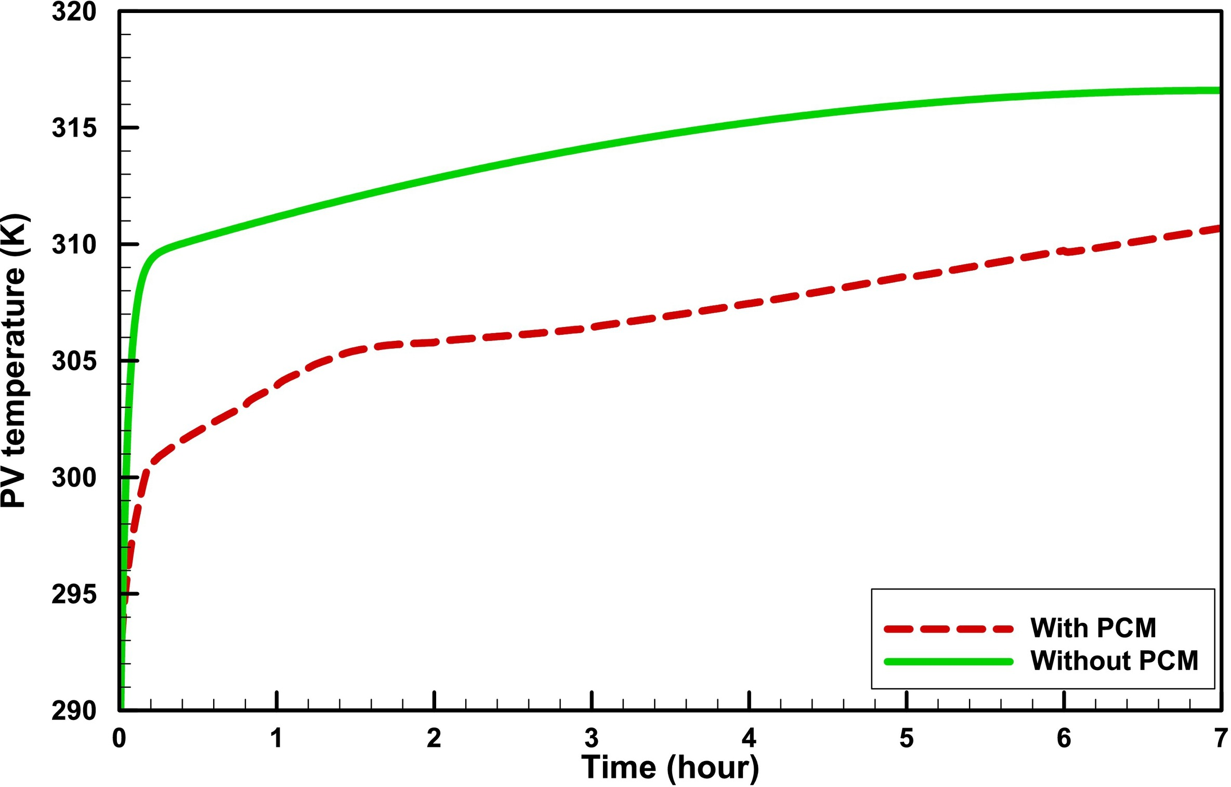
Results and Discussion
The temperature of PV is an important parameter in the performance of PV-PCM system, as it effects the efficiency of the of PV panel
Using the PCM decrease the temperature of the PV panel on average by 6.9 K
The temperature of PV panel increase significantly and reaches up to 300 K within 10 min when the back of the PV panel is solid
After it is melted the increase rate of PV panel temperature decreases and the panel temperature reaches 305K in appx. 90 min
Fig. 7. Temperature variation of PV panel with time.
Heat Transfer and Reactive Flow Lab

Slide 12
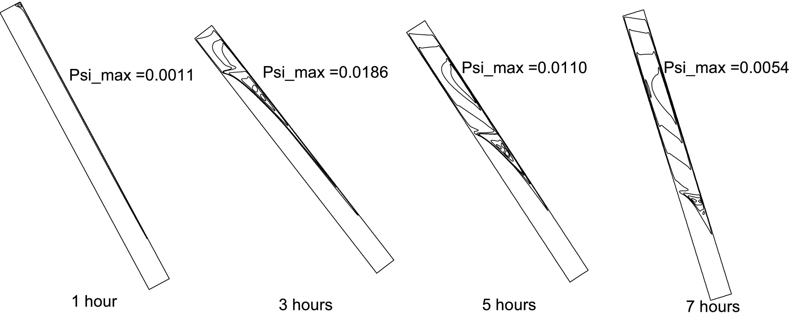
Streamlines
Fig. 8. Streamlines at different times.
Heat Transfer and Reactive Flow Lab

Slide 13
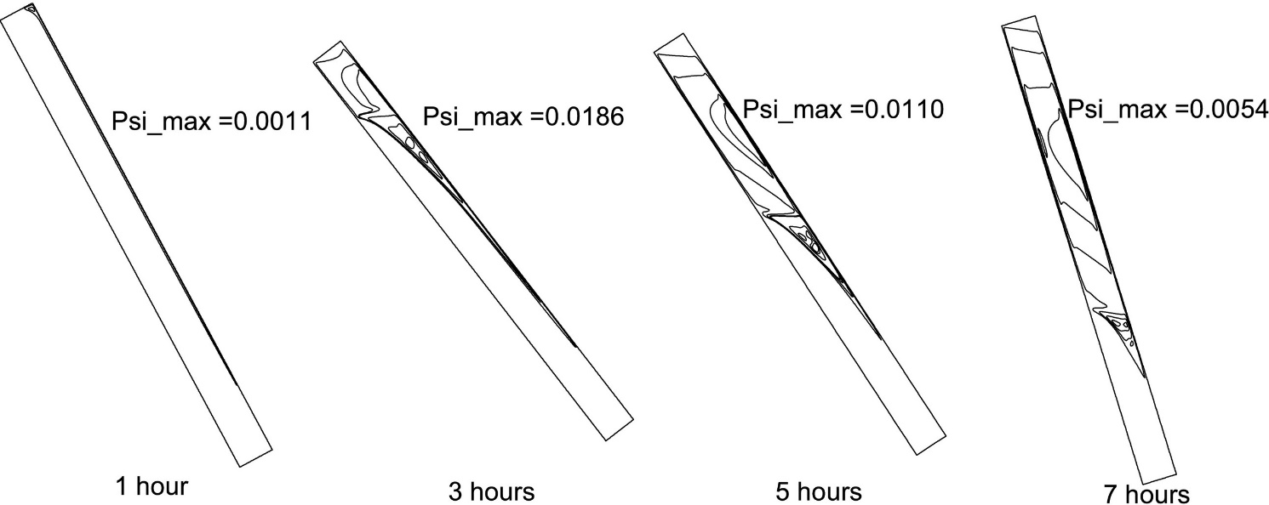
Streamlines
A small vortex is formed at the container’s top corner near the heated wall at t =1h
The vortex create a counter-clockwise circulation cell in the molten material near the panel surface
The circulation cell receive heat from the panel and transfer it to the solid-liquid interface, thus increasing the melting rate
Fig. 8. Streamlines at different times.
Heat Transfer and Reactive Flow Lab

Slide 14
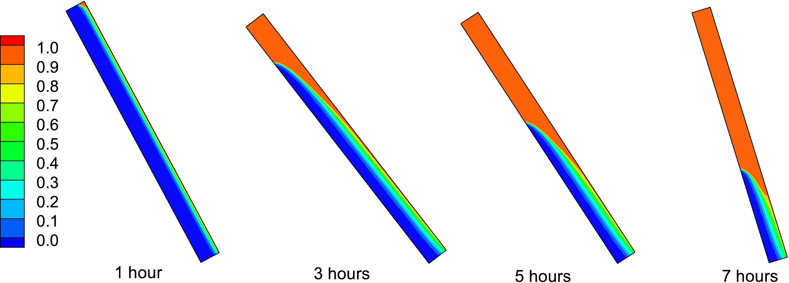
Liquid Fraction
Fig. 9. Liquid fraction of PCM at different times
Heat Transfer and Reactive Flow Lab

Slide 15
Liquid Fraction
A small amount of PCM at the top of the corner near the heated wall is melted at 1h, while the other PCM are solid
Vortexes are formed in melted PCM by buoyancy forces, and the natural convection increases the amount of liquid PCM
Fig. 9. Liquid fraction of PCM at different times
Heat Transfer and Reactive Flow Lab

Slide 16
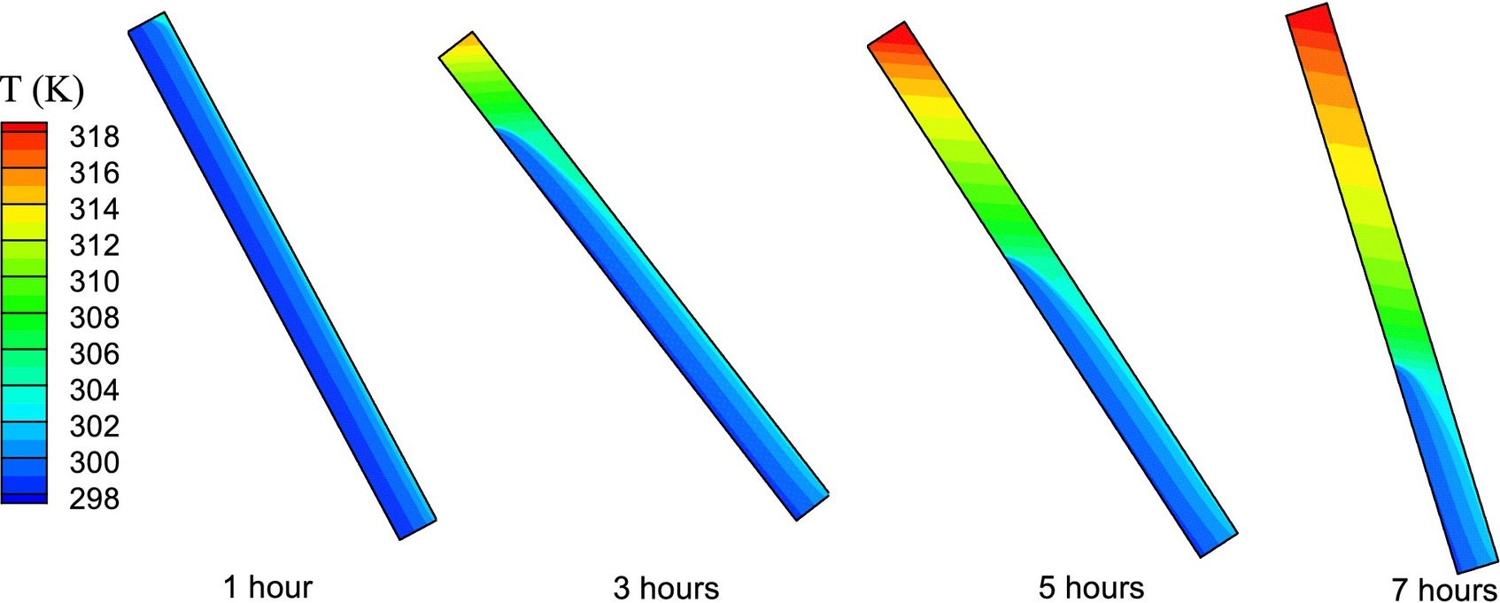
Temperature Distribution
Fig. 10. Temperature distribution at different times.
Heat Transfer and Reactive Flow Lab

Slide 17
Temperature Distribution
After 1 h the PCM temperature is lower than the melting point except for the container’s top, at this time the temperature distribution in solid PCM shows that heat is transferred by conduction from the right wall to the left wall increasing the temperature of solid PCM
The formation of vortex in upper corner of PCM rise the temperature of the molten PCM at the top of the container
The pattern of isotherms shows that in molten PCM , natural convection is the dominant heat transfer mechanism
Fig. 10. Temperature distribution at different times.
Heat Transfer and Reactive Flow Lab

Slide 18
Conclusion
As long as the phase change material is solid, its temperature changes rapidly due to conduction heat transfer.
As the temperature of the PCM reaches the melting point, its temperature remains almost constant over a relatively long time.
As soon as the melting process is completed at a given point, the temperature at that point rises at a considerable rate
After melting a sufficient amount of the PCM, a circulating cell is formed in the molten material. The circulation of this cell slows down the temperature increase of the melt.
When the phase change material is melted at points close to the panel, the PCM temperature at distances farther from the PV panel is almost constant, although the material at these points is still in the solid phase
Heat Transfer and Reactive Flow Lab

Slide 19

THANK YOU
19

